Slide 1
Credit card fraud detection classifier using ML and deep learning
BY
Nishad Chaoji
Regno – 170953046
Branch - CCE

Slide 2
Flow of talk
Introduction
Problem Statement
Literature Review
Methodology
Results and discussion
Conclusion and future work
References

Slide 3
Introduction
With India heading towards capitalism , the usage of credit cards has increased drastically in the last decade . Due to the surge in credit card usage the no of frauds have also been on the rise in recent times .
According to RBI data, a total of 4,071 fraud cases were reported by Indian lenders between April and September 2021 and the amount involved in these frauds was Rs 36,342 crore
Fraud detection involves monitoring the activities of populations of users to estimate, perceive or avoid objectionable behaviour, which consists of fraud, intrusion, and defaulting.
This is a very relevant problem that demands the attention of communities such as machinelearning where the solution to this problem can be automated. Machine Learning algorithmsare deployed to study their models, train accordingly, and detect fraudulent transactions

Slide 4
There are many different kinds of credit card fraud strategies present like Credit card frauds, Card theft,
Account bankruptcy, Device intrusion, Application fraud, Counterfeit card, etc.
This is a very relevant problem that demands the attention of communities such as machinelearning where the solution to this problem can be automated. Machine Learning algorithmsare deployed to study their models, train accordingly, and detect fraudulent transactions.

Slide 5
Problem Statement
We have to find the best model created by training various different Algorithms and comparing them using metrics like Accuracy Score, Recall Score, Precision Score , ROC_AUC Score , Confusion Matrix .

Slide 6
Literature Survey
This Section includes
1. Papers Referred
2. Tools and Libraries
3.Preprocessing data
4. Balancing Dataset using Oversampling techniques ( ADASYN )
5. Removing Outliers
6. Model Hyper parameter tuning
6.1 Randomized Search CV
6.2 Grid search CV
7 . Machine Learning

Slide 7
Papers Referred
[1]Dejan Varmedja: Proposed Various Machine learning algorithms for credit cardfraud detection and analyzed them. The models used were Logistic Regression, RandomForest, and Multilayer perceptron which is an ANN algorithm.
[2] Haibo He, Yang Bai, Edwardo A. Garcia : a novel adaptive synthetic (ADASYN)sampling approach for learning from imbalanced data sets. The essential idea of ADASYN is to use a weighted distribution for different minority class example according to their level of difficulty earning

Slide 8
[3] A Candel, V Parmar, E LeDell : Proposed a study on the H2O deep learning Model
[4] Sai Kiran: proposed an improved algorithm for credit card fraud detection. That is named as Naïve Bayes improved K-nearest Neighbor method (NBKNN). They have used a dataset on which they had applied the algorithms to identify the fraudulent transaction in the taken dataset.

Slide 9
Tools and Libraries
Tools and Libraries used are
Data pre processing and Analysis
Pandas
Numpy
Matplotlib
Seaborn
Imbalanced learn
Machine learning
Sk-learn
Catboost
XG boost
Lightgbm
H2O

Slide 10
Pre-processing Data
Pre-processing of data includes steps like removing null values , balancing imbalanced data and removing outliers. Null vaues are those in which the factoring class value is Null or NAN. These can be simply removed by displaying them and deleting them at one go .

Slide 11
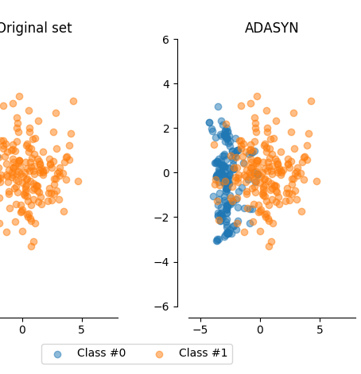
Balancing Dataset using Oversampling techniques ( ADASYN )
Oversampling is a dataset balancing technique that creates artificial data for the minority class. There are many sampling techniques like SMOTE , ADASYN etc .
Here we are going to perform oversampling with ADASYN as ADASYN works best when the minority values are tightly packed with each other in form of clusters .
From the image on the right it can be seen how the
Minority data points have increased significantly
After implementing ADASYN and all are tightly knit
With each other .

Slide 12
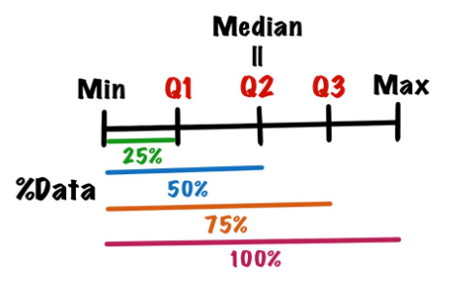
Removing Outliers
Outliers are data that lie outside the overall data distribution or is very distant from the remaining data points in the sample. This can be found by plotting the correlation matrix . The features that have high negative correlation are mostly the ones that have outliers . One common method to remove these is the IQR method . In the IQR method the data points are divided into 4 equal parts .
The interquartile range method defines outliers as values larger than Q3 + 1.5 * IQR or the values smaller than Q1 – 1.5 * IQR. Once we get the list of outliers we can simply remove them from the dataframe

Slide 13
Model Hyper parameter Tuning
It is the Process in which the parameters of the model are changed to enhance the model performance. In this the Hyper tuning algorithms find the best params that can be used .
In this module we are going to discuss two types of Hyper parameter tuning modules .
Randomized Search CV
Grid SearchCV

Slide 14
Randomized Search CV
In this algorithm the best parameters are selected by the model by running the model by trying out different combinations made by the defined params.The no of iterations also has to be defined and it only makes that many iterations and finds the best params out of it . Eg of Randomized search cv
Depth = [3,4,5] , N_tree = [40,50] , n _iters = 3
All_combinations = {(3,40),(3,50),(4,40),(4,50),(5,40),(5,50)} .
However since n_iters = 3 , only 3 iterations will occur so the combinations would be
Counted_Combinations = {(3,40),(3,50),(4,40)}
The model will pick the one out of the three which has the best results.

Slide 15
Grid Search CV
Grid search cv is a hyper parameter tuning algorithm like Randomized search cv which gives the best parameters to be used while training the Model .
Grid Search CV determines the best params by iterating the model with all the possible combinations and returns the best params .
Compared to Randomized Search CV , Grid search CV takes longer computational time because it runs for all the iterations in the grid . Below shows the
Depth = [3,4,5] , N_tree = [40,50]
All_combinations = {(3,40),(3,50),(4,40),(4,50),(5,40),(5,50)} .
Here there is no limitations to no of iterations so the training will happen for all the above
Iterations and the best model will be picked after this .

Slide 16
Machine Learning Models
Before scripting the algorithms the first step is to split the dataset into the independent variable x and the dependent variable y that has the factoring class . These get split into training data and testing data with X_train and X_test being the dependent variables of the training data and testing data and y_test and y_train being the dependent variable of the training and test variables respectively .
The Machine learning model are created by training the model using the training data . The algorithm analyses the input data and learns on its own .
Once the model training is complete the model is tested by putting in the test data and check for the predictions and find the model Metrics .

Slide 17
Methodology
This section includes :
1. About the Dataset
2. Balancing the Dataset
2.1 ADASYN Diagram
3. Splitting the Dataset
4. Models Architecture
4.1 Naïve Bayes Model
4.2 CatBoost Model
4.3 LGBM Model
4.4 Xg Boost Model
4.5 H2O estimator Model

Slide 18
About the dataset
The dataset is picked from Kaggle and contains credit card transactions from a European bank ( 2days data) .The dataset has 31 columns or 31 features The below table shows some of the entries in the dataset.
Amount – Transaction amount in euros
Time – Transaction time in seconds .
V1 – V29 – Encrypted Customer data
Class – Factoring Class , 0 – Non-fraud , 1 – Fraud
Amount | Time(secs) | V1 , V2 , V3 ………V27,V28 | Class
17 | 0 | 0.966271711572087, ………. | 0
23 | 0 | 0.185226008082898,………….. | 0
1000 | 1 | -1.79299333957872,………….. | 0

Slide 19
Balancing the dataset
The dataset acquired from Kaggle contains very few negative datapoints or we can say is imbalanced. Only 479 out of 284784 transactions are fraudulent , so tackle this problem we use ADASYN .
class = 0 284315
Class = 0
284315
ADASYN ALGO
class = 1 479
Class = 1
284314

Slide 20
ADASYN DIAGRAM
ADASYN Connects all the minority points with one another and draws the synthetic Samples on those Lines .
Also ADASYN adds other features to the synthetic data and not just the factoring Class .
After ADASYN , The next step is to remove the outliers
Blue – Minority Class
White- MajorityClass
Orange – Synthetic Samples of minority class .

Slide 21
Splitting the Dataset
The Dataset is Split using the train-test-split algorithm which is available in the Sklearn library .
The data set split is
Training -341176
Testing – 159216
Validtion - 44244
X_train
Independent Variable
X = DF – DF.Class
X_test
DataFrame
X_test
X_val
Dependent Variable
Y = DF.Class
Y_train
Y_test
Y_test
Y_val

Slide 22
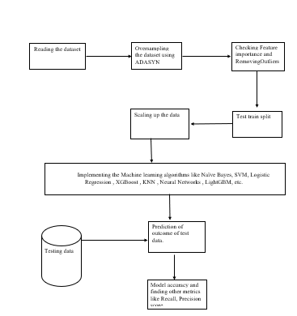
Models architecture
The figure below shows the overview of system architecture of how the model will work.

Slide 23
Naïve Bayes Model
Here for the Model the algorithm used is Multinomial Naïve Bayes . The term Naïve is used because it assumes that occurrence of a certain feature is independent of the other features . The work flow of naïve bayes looks like
Training Data
Prediction using the test data
Naïve Bayes Algorithm
Evaluating the Model using the Metrics
Best Params
Best Params grid
Grid search Algorithm
Validation Data
Params = { alpha : [1,3,5], verbose:3, fit_prior:[‘true’,’false’]}

Slide 24
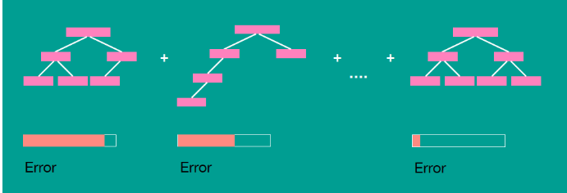
Catboost Classifier
Catboost is a boosting Algorithm that uses the principal of gradient boosting of Decision trees . In this algorithm each tree rectifies the mistakes of its predecessor . The below image shows how gradient boosting works in catboost.

Slide 25
Training Data
Catboost
Algorithm
Prediction using the test data
Evaluating the Model using the Metrics
Best Params
Best Params grid
Random search CV Algorithm
Validation Data
Params ; {
depth = [5,6,7],iterations = 200,learning_rate = 0.1,l2_leaf_reg = 0.1,loss_function= 'Logloss’ }

Slide 26
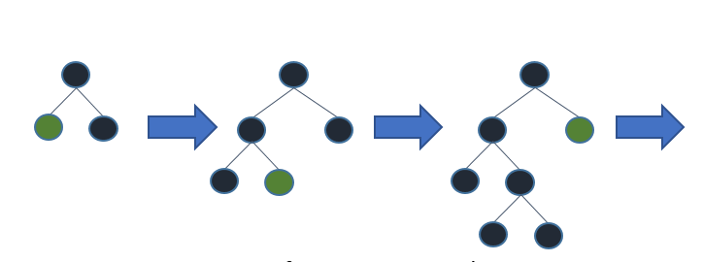
LightGBM
LightGBM is another gradient boosting framework based on decision trees. It supports both parallel and GPU learning. Unlike other boosting algorithms LightGBM grows leafwise and not treewise . This results in faster computational time
The above image shows the leafwise growth of the tree , Accuracy increases with each growing leaf .

Slide 27
Training Data
LightGBM
Algorithm
Prediction using the test data
Evaluating the Model using the Metrics
Best Params
Best Params grid
Grid search CV Algorithm
Validation Data
params = {
'max_depth’: [6,8,10,14], 'learning_rate’: [0.1,0.15,0.2],
'num_leaves’: [10,20,30] }

Slide 28
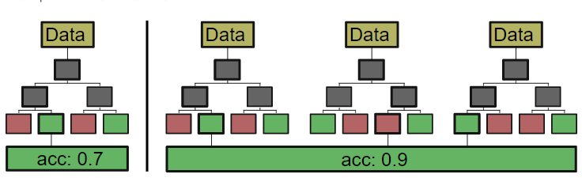
XG Boost
XGBoost , is one of the oldest and most widely used gradient boosting algorithm and uses the trees architecture . Like other boosting algorithms this also grows treewise and increases its accuracy with each tree correcting the mistakes of its predecessor tree .

Slide 29
Training Data
XGBoost
Algorithm
Prediction using the test data
Evaluating the Model using the Metrics
Best Params
Best Params grid
Grid search CV Algorithm
Validation Data
Params grid = {'min_child_weight': [1, 5, 10], 'gamma': [0.5, 1, 1.5, 2, 5],'subsample': [0.6, 0.8, 1.0],'Colsample_bytree': [0.6, 0.8, 1.0],
'max_depth': [3, 4, 5]}

Slide 30
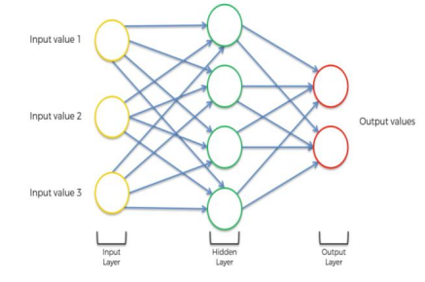
H2O Estimator
The H2O estimator is a framework based on artificial neural networks. It contains many advanced features like adaptive learning rate, rate annealing, , momentum training etc. It contains many layers of interconnected neurons starting with an input layer, a middle layer and an ending layer .
Input layer – . The starting input contains feature space
Middle layer - contains nonlinear hidden layer .
Output layer – classification or a regression layer

Slide 31
H2O model
{
epochs=1000,
distribution = 'bernoulli',
variable_importances=True,
nfolds = 2,
fold_assignment = "Stratified“
stopping_metric = 'logloss',
loss = 'CrossEntropy'
}
Predicting the model metrics
Training Data
Cross validation data
Converting DF to H2O DF
Testing Data

Slide 32
Results and Discussions
This Section Contains
Results Naïve Bayes
Results Catboost
Results LightBGM
Results XGBoost
Results H2O
Metrics Table .

Slide 33
Results Naïve Bayes
Class | Precision | Recall | F1 | AUC | Accuracy
Non-Fraudulent | 0.79 | 0.75 | 0.78 | 0.78 | 0.77
Fraudulent | 0.76 | 0.80 | 0.77 | 0.78 | 0.77
Overall | 0.762 | 0.796 | 0.78 | 0.78 | 0.77
Class | Precision | Recall | F1 | AUC | Accuracy
Non Fraudulent | 0.75 | 0.88 | 0.81 | 0.79 | 0.79
Fraudulent | 0.85 | 0.70 | 0.77 | 0.81 | 0.80
overall | 0.85 | 0.70 | 0.77 | 0.79 | 0.79
Model Metrics before Parameter tuning Model Metrics after Paramter tuning
From the above metrics table we can clearly see an increase in the model metrics which can be confirmed from the confusion matrix

Slide 34
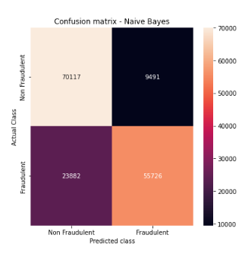
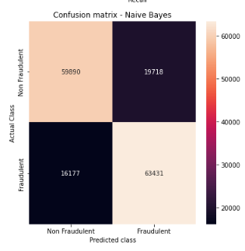
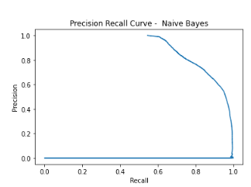
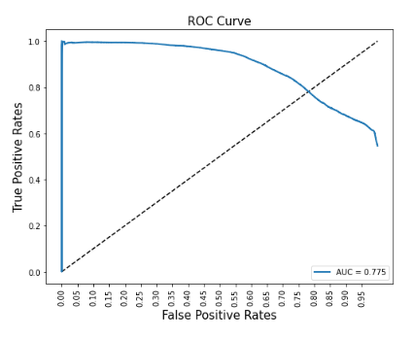
Confusion Matrix Confusion Matrix After
before tuning Tuning
From the two confusion matrix it is clearly visible that the no of false values has reduced by over 3000 datapoints. Below are the roc curve and precision recall curve of the model

Slide 35
Class | Precision | Recall | F1 | AUC | Accuracy
Non Fraudulent | 0.995 | 1 | 0.979 | 0.997 | 0.997
Fraudulent | 1 | 1 | 1 | 1 | 1
overall | 0.995 | 1 | 0.979 | 0.997 | 0.997
Class | Precision | Recall | F1 | AUC | Accuracy
Non Fraudulent | 0.9966 | 1 | 0.999 | 0.999 | 0.999
Fraudulent | 1 | 1 | 1 | 1 | 1
overall | 1 | 1 | 0.999 | 0.999 | 0.999
Metrics table catboost Metrics table catboost after tuning
From the above Metrics table we can see that there is no significant change that is visible here however the change can be seen in the confusion matrix

Slide 36
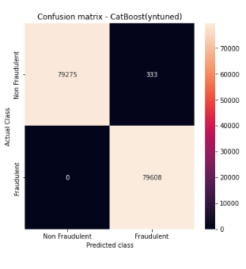
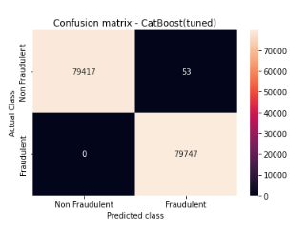
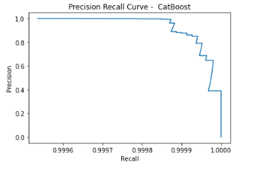
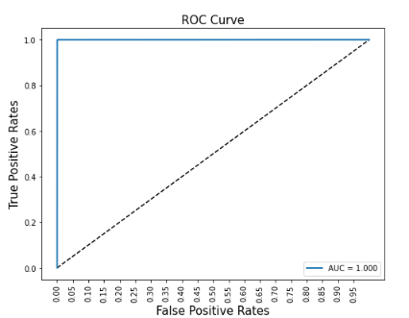
Confusion Matrix Catboost Confusion matrix CatBoost tuned
From the above Confusion matrices we can see visible change with the no of false values going from 355 all the way to 53 , thus increasing the overall model performance . Below are the ROC and precision curves of the model.

Slide 37
Results LightGBM
Class | Precision | Recall | F1 | AUC | Accuracy
Non Fraudulent | 0.99 | 0.99 | 0.99 | 0.99 | 0.99
Fraudulent | 1 | 1 | 1 | 1 | 1
overall | 0.9991 | 0.9997 | 0.9994 | 0.9995 | 0.9994
Class | Precision | Recall | F1 | AUC | Accuracy
Non Fraudulent | 0.99 | 0.99 | 0.99 | 0.99 | 0.99
Fraudulent | 1 | 1 | 1 | 1 | 1
overall | 0.9991 | 0.9997 | 0.9994 | 0.9995 | 0.9994
Model metrics LGBM untuned Model metrics LGBM tuned
From the above confusion matrices there is no visible change in the metrics as the model metrics even before hyperparameter tuning were very good . However a small change can be seen in the confusion matrices .

Slide 38
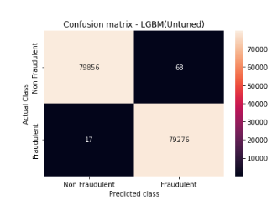
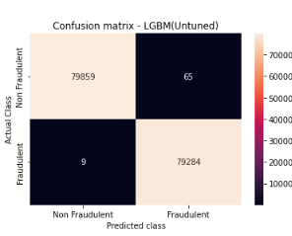
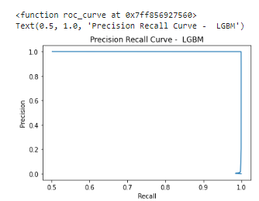
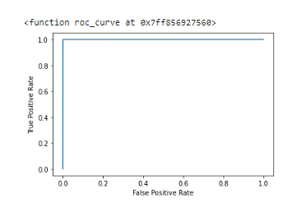
Confusion Matrix of lgbm untuned Confusion Matrix of lgbm tuned
From the confusion matrix it is seen that the number of false negatives and false positives are reduced from 85 to 74 which is not a significant change however it is still an improvement over the previous results. Below are the precision-recall curve and the ROC curve of the given Model

Slide 39
Results XG Boost
Class | Precision | Recall | F1 | AUC | Accuracy
Non Fraudulent | 0.98 | 0.989 | 0.99 | 0.98 | 0.99
Fraudulent | 0.99 | 0.97 | 0.99 | 0.99 | 0.99
overall | 0.985 | 0.979 | 0.9868 | 0.986 | 0.986
Class | Precision | Recall | F1 | AUC | Accuracy
Non Fraudulent | 0.98 | 0.989 | 0.99 | 0.98 | 0.99
Fraudulent | 0.99 | 0.97 | 0.99 | 0.99 | 0.99
overall | 0.985 | 0.98 | 0.986 | 0.98 | 0.987
Metrics XGBoost untuned
. Metrics Xgboost Tuned
From the above metrics table, a slight improvement can be seen in the metrics of the model. This can be seen better in the confusion matrix

Slide 40
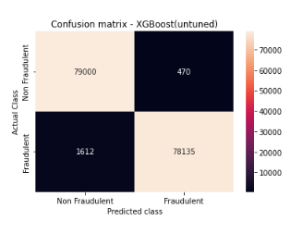
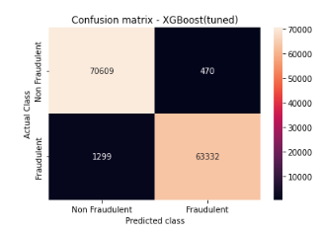
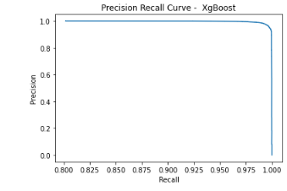
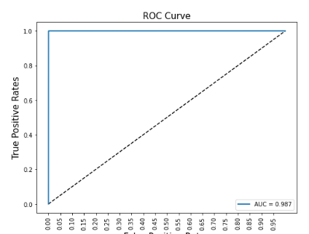
Confusion Matrix untuned Confusion Matrix tuned
From the above figures , the no of false positives and false negatives has reduced by 333 data points after hyper parameter tuning. Below are the Precision-Recall curve and the ROC Curve

Slide 41
Results H2O estimator
No of epochs run = 1000
Distribution = Bernoulli Distribution
 | Non-Fraudulent (0) | Fraudulent (1) | Rate of false value
Non-Fraudulent (0) | 170809 | 89 | 89/170898
Fraudulent (1) | 7 | 170271 | 7/170278
Overall | 170816 | 170360 | 96/341176
LogLoss: | 0.005753125992453461
Mean Per-Class Error: | 0.00034167588267096285
AUC: | 0.9997523059422343
Metrics table for the training data for the H2o Confusion matrix training data
LogLoss: | 0.0036774895622737895
Mean Per-Class Error: | 0.00034167588267096285
AUC: | 0.9998481069531275
 | Non-Fraudulent (0) | Fraudulent (1) | Rate of false value
Non-Fraudulent (0) | 21195 | 12 | 12/21207
Fraudulent (1) | 5 | 21232 | 5/21237
Overall | 21200 | 21244 | 17/42444
Metrics table cross validation
Confusion Matrix of the cross validation

Slide 42
Precision | Recall | AUC
0.9998827529604878 | 0.9999162493090568 | 0.9999084659064857
Metrics table for H2O estimator
 | Non-Fraudulent | Fraudulent | Rate of false value prediction
Non-Fraudulent | 79187 | 8 | 8/79198
Fraudulent | 11 | 80010 | 11/80018
Overall | 79198 | 80018 | 19/159216
Confusion matrix
From the above confusion matrix Table it can be confirmed that the model is performing well giving only a total of 19 false values out of 159216 total datapoints.

Slide 43
Overall Metrics Table
MODEL | Precision | Recall | Accuracy | AUC | Training Time
NB | 0.762 | 0.796 | 0.78 | 0.78 | 4.6s
NB + Parameter tuning | 0.861625 | 0.700595 | 0.794041 | 0.794040 | 15.2s
Cat Boost | 0.995759 | 1.000000 | 0.997870 | 0.997870 | 179.5s
Catboost + Parameter Tuning |  |  |  |  | 1135.6s
LightGBM | 0.9991 | 0.9997 | 0.9995 | 0.9994 | 78.4s
LightGBM + parameter tuning | 0.9991 | 0.9997 | 0.9995 | 0.9994 | 800s
XG Boost | ~0.99 | 0.97986 | 0.987692 | 0.986935 | 244s
XGBoost + parameter tuning | ~0.99 | 0.9799 | 0.987696 | 0.986944 | 1375.3s
H20 (Training ) | - | - | - | 0.999848 | 140814.8s
H20 (Testing) | 0.9999162 | 0.999428 | 0.99989 | 0.9999487 | -

Slide 44
Conclusions and future work
From the above Metric table, the following conclusions can be made
The 3 Boosting algorithms work better here than the Classification algorithm when purely comparing just machine learning.
Naïve Bayes is the Fastest algorithm in terms of training and computation time but time but that does not mean faster is always better.
Deep Learning model performs better than the Machine Learning model however the training and computation time is too much for it because of a complex architecture and not powerful enough GPU.

Slide 45
This research is being carried out to offer a multiclass classifier to detect the fraud credit card transactions from the genuine ones. It also aids in the development of customized Fraud detection Software’s.. The metrics on which the model performance will be evaluated were confusion matrices, AUC score, Precision, Recall,and Accuracy score of the above models
Practically the best model for our requirement after observing the above outputs and graphs would be Cat Boost in Machine learning Models, and the deep learning model gives better results than machine learning models however the computational time is too high in the case of deep learning
In the future for this application the model can be enhanced by using better machines or can be implemented on cloud and in the process multiple rounds of hyper tuning can be run ,more deep learning algorithms like MLP and LSTMs and also hyper tune the deep learning model

Slide 46
References
[1] Pelin Yıldırım Taşer, Fatma Bozyiğit. "Chapter 7 Machine Learning Applications for Fraud Detection in Finance Sector”, Springer Science and Business Media LLC, 2022
[2] Carcillo, F., Dal Pozzolo, A., Le Borgne, Y.-A., Caelen, O., Mazzer, Y., & Bontempi, G. (2018). SCARFF: A scalable framework for streaming credit card fraud detection with spark. Information Fusion, 41, 182–194.
doi: 10.1016/j.inffus.2017.09.005.
[3] Carcillo, F., Le Borgne, Y.-A., Caelen, O., Kessaci, Y., Oblé, F., & Bontempi, G. (2019). Combining Unsupervised and Supervised Learning in Credit Card Fraud Detection. Information Sciences.
doi: 10.1016/j.ins.2019.05.042.
[4] Cheng, D., Xiang, S., Shang, C., Zhang, Y., Yang, F., & Zhang, L. (2020). Spatio-Temporal Attention-Based Neural Network for Credit Card Fraud Detection. Proceedings of the AAAI Conference on Artificial Intelligence, 34(01), 362–369. doi:10.1609/aaai. v34i01.5371.
[5] De Sá, A. G., Pereira, A. C., & Pappa, G. L. (2018). A customized classification algorithm for credit card fraud detection. Engineering Applications of Artificial Intelligence, 72, 21-29.

Slide 47

THANK YOU

